Slide 1
Advanced Automation Pipelines
Adam Anderson
Notes:
Welcome to Delivering business value faster.

Slide 2
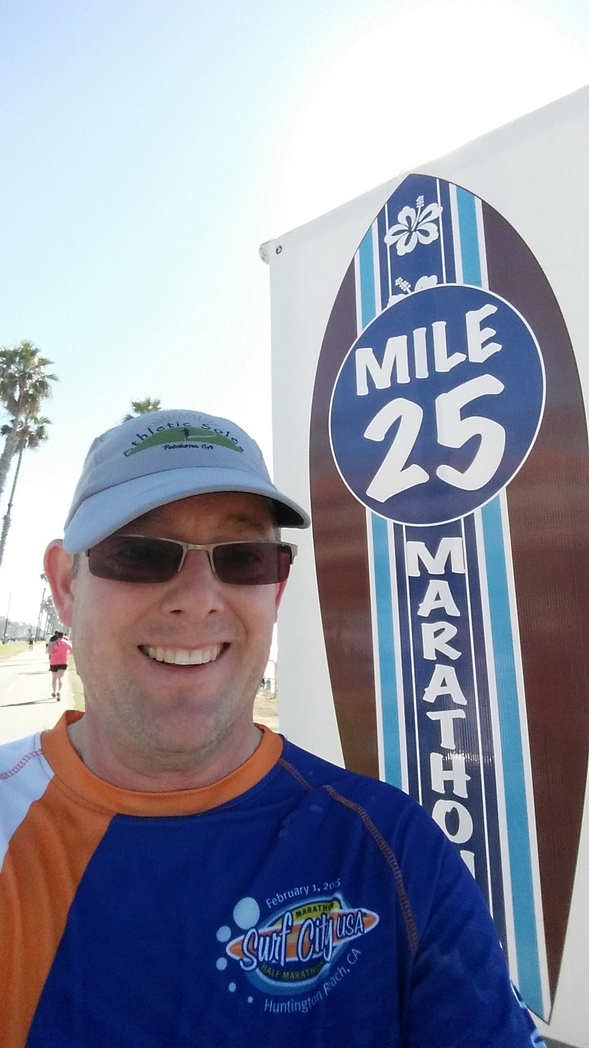
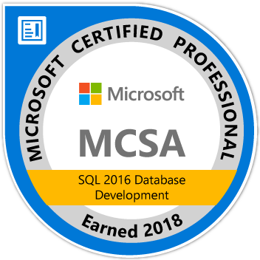
About Me
Adam Anderson
@SQLPioneer
sqlpioneer.wordpress.com
www.linkedin.com/in/adam-anderson-dba
https://github.com/SQLPioneer/
Notes:
My name is Adam Anderson, and I have been a database developer for over 10 years and in IT for more than 20. I am MCSA certified and will be taking my final test in a month or two to get my MCSE.
So I have a friend that is a financial accountant and he always droned on about ROI and how most people didn’t understand it. When I asked what he meant he told me that if you invest 100,000 dollars and a year later you get 12,000 dollars in return that was a 12% ROI and most companies would take that and run. However, if you can start making a 1000 dollars a month it is still the same money

Slide 3

Agenda
Introduction
DevOps Pipelines
Architecture Patterns
Application and Database
Tightly Coupled Databases
Environment Automation
Summary

Slide 4
DevOps Pipelines

Slide 5


Slide 6

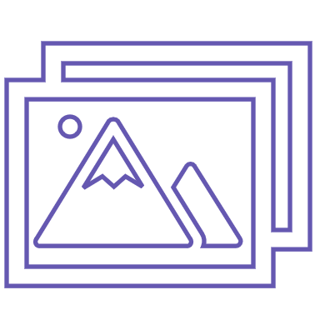

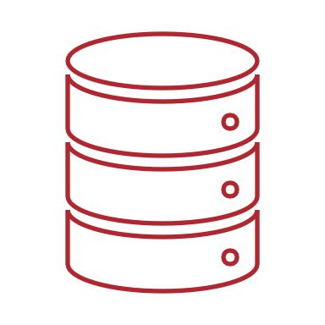


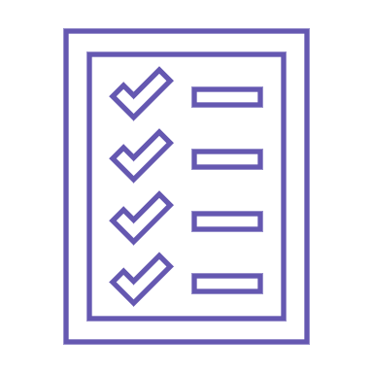




Pipeline Overview
Build
Release
Publish
Artifact
Deploy to Test: DB, APP and Test
Code Push
Triggers
Build
Deploy to Prod: DB and APP
Create
Artifact
Unit
Test

Slide 7
Controls for Build and Releases
Build
Release
Pull Requests
Manual
Trigger
Time Based
Tests
Gates
Approver
Triggers
Time
Build Complete
Code Check In
Manual

Slide 8









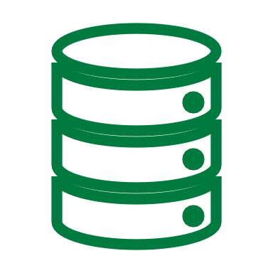
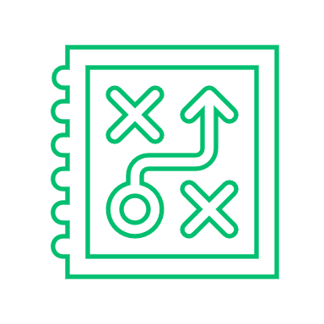


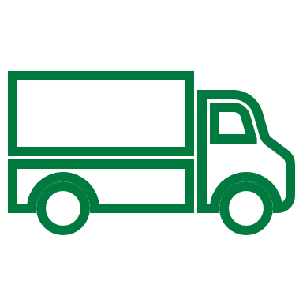
Pipeline Overview
Test Driven
Development
Build Pipeline
Planning
Source Control / Artifact Repository
Production
Dev
Integration
Testing
Environment Setup
Cost of Change

Slide 9
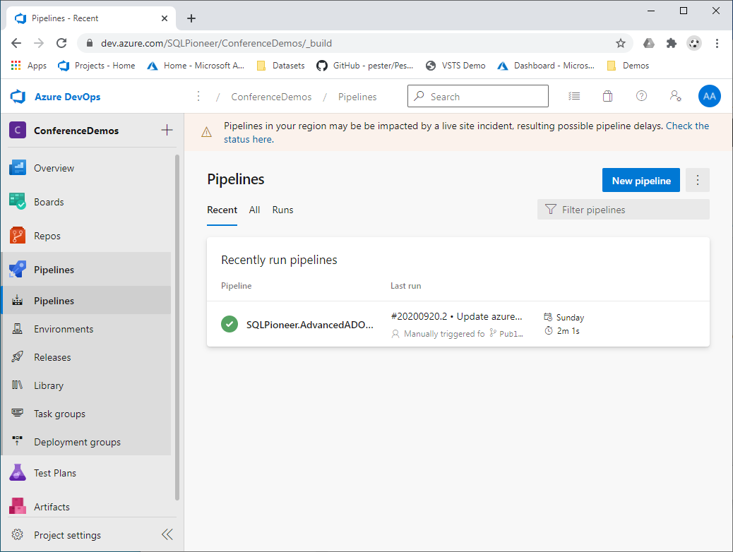
View All Pipelines

Slide 10
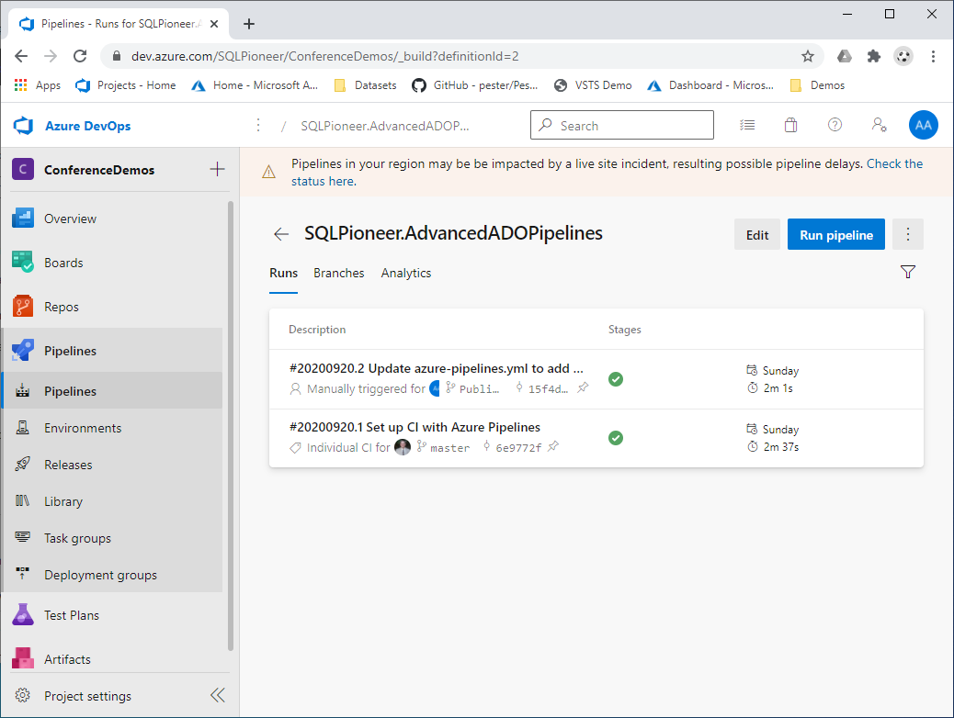
Manage Pipeline

Slide 11
YAML Scaffeling
trigger:
- master
pool:
vmImage: 'windows-latest'
variables:
solution: '**/*.sln'
buildPlatform: 'Any CPU'
buildConfiguration: 'Release'

Slide 12
steps:
- task: NuGetToolInstaller@1
- task: NuGetCommand@2
inputs:
restoreSolution: '$(solution)'
- task: VSBuild@1
inputs:
solution: '$(solution)'
msbuildArgs: $(args)
platform: '$(buildPlatform)'
configuration: '$(buildConfiguration)'
- task: VSTest@2
inputs:
platform: '$(buildPlatform)'
configuration: '$(buildConfiguration)'
- task: PublishBuildArtifacts@1
displayName: PublishDatabase
inputs:
PathtoPublish: '$(Build.SourcesDirectory)/SchoolProject/bin/Release/'
ArtifactName: 'SchoolProjectDB'
publishLocation: 'Container'
- task: PublishBuildArtifacts@1
displayName: PublishApp
inputs:
PathtoPublish: '$(Build.SourcesDirectory)/PipelinesProject/bin/Release/netcoreapp3.1/'
ArtifactName: 'PipelinesProject'
publishLocation: 'Container'

Slide 13
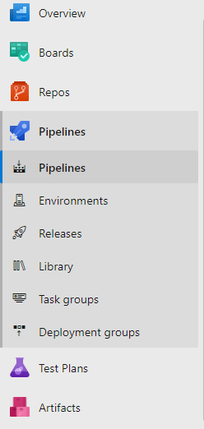

Slide 14
Architecture Deployment Patterns

Slide 15


Slide 16

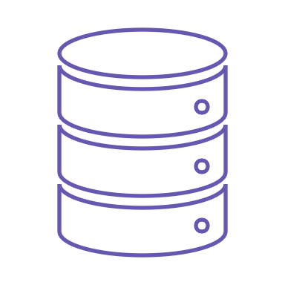


Application and Database Build
Create
Artifact
Publish
Artifact
Build Agent
Build
Unit Test
Code Push
Database
Application

Slide 17
Application and Database Release
Deploy DB and Test
Deploy App and Test
Artifacts Need
for Deployment
Release
Deploy DB
Artifact
Repository
Release
Agent
Deploy App

Slide 18
Tightly Coupled Databases Builds
Publish
Artifact
Create
Artifact
Code Push
Unit Test
Build
Build Agent
Build Agent includes all objects necessary for build
Databases
Linked Servers

Slide 19


Slide 20

Tightly Coupled Database Release
Deploy DB and Test
Deploy App and Test
Artifacts Need
for Deployment
Release
Deploy DB
Artifact
Repository
Release
Agent
Deploy App

Slide 21





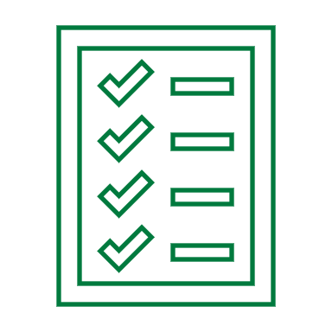
Environment Automation
Release
Agent
Test Setup
Azure VM
Template
Azure SQL DB
Code Push
Container Registry
On Prem Custom Scripts

Slide 22


Slide 23
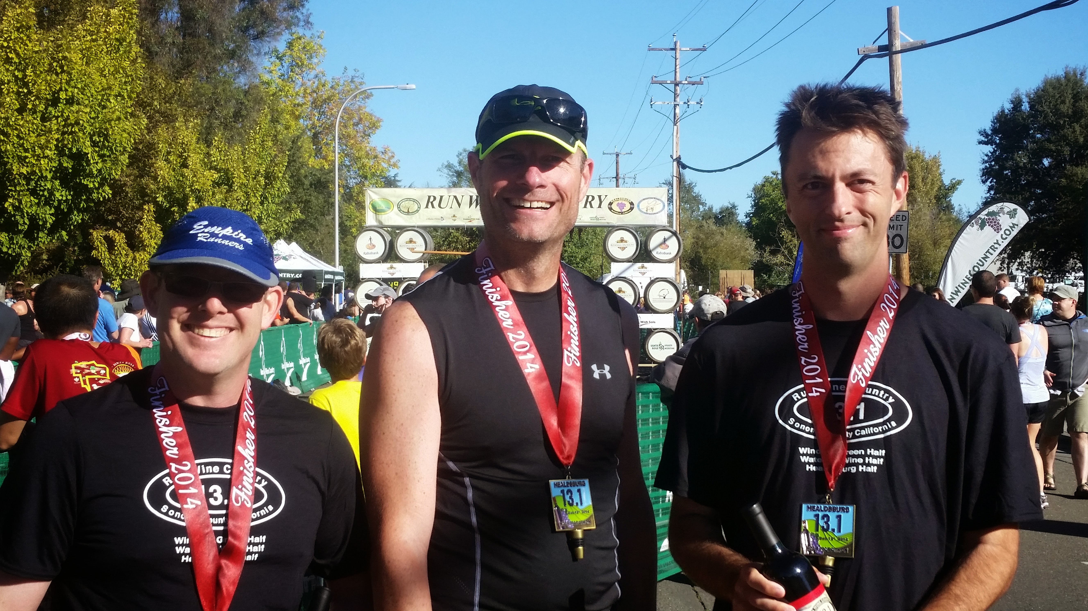
Summary
Build early and often
Release
Environment Automation

Slide 24
Contact Information
Adam Anderson
@SQLPioneer
sqlpioneer.wordpress.com
www.linkedin.com/in/adam-anderson-dba
https://github.com/SQLPioneer/
Notes:
My name is Adam Anderson, and I have been a database developer for over 10 years and in IT for more than 20. I am MCSA certified and will be taking my final test in a month or two to get my MCSE.
So I have a friend that is a financial accountant and he always droned on about ROI and how most people didn’t understand it. When I asked what he meant he told me that if you invest 100,000 dollars and a year later you get 12,000 dollars in return that was a 12% ROI and most companies would take that and run. However, if you can start making a 1000 dollars a month it is still the same money

Slide 25
Prioritize Work
Automated Build
Application
Database
Testing
Unit Test
Integration Testing
Environment Automation
Initialization
User Acceptance
Performance
Configuration
Testing

